Slide 1
Review

Slide 2
Summary
Basic concepts of system models
State-space representations
Linear transform of state-space model
Transfer Function Matrix
Solutions of linear state-space model
Controllability and observability
State feedback and state observer

Slide 3
Basic concepts of system models
A ‘system’ is a group of interacting, interrelated, or interdependent components or parts that function together as a whole to accomplish a goal.
Inputs
u(t)
Outputs
y(t)
Plant
(x1, x2,…, xn)
Input variable
1.Input-output description
Output variable
State variable
2.State-space description

Slide 4
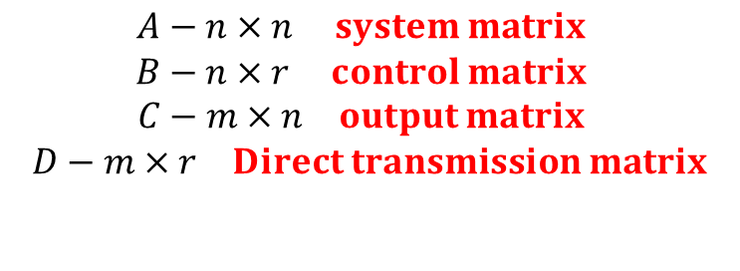
State-space model
Linear continuous system
Linear discrete system
$$\begin{matrix}A−n×n system matrix \\ B−n×r control matrix \\ C−m×n output matrix \\ D−m×r Direct transmission matrix \\ \\ \end{matrix}$$

Slide 5
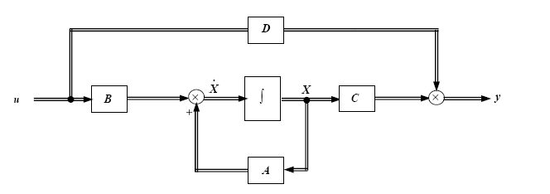
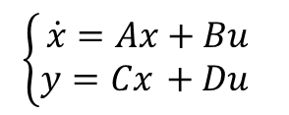
State block diagram
Three basic units
（1）Integrator
（2）Adder
（3）Scaler
$$\left\{\begin{matrix}\dot{x}=Ax+Bu \\ y=Cx +Du \end{matrix}\right.$$
Remark: D goes outside the states, and
is considered as one of outer effect.

Slide 6

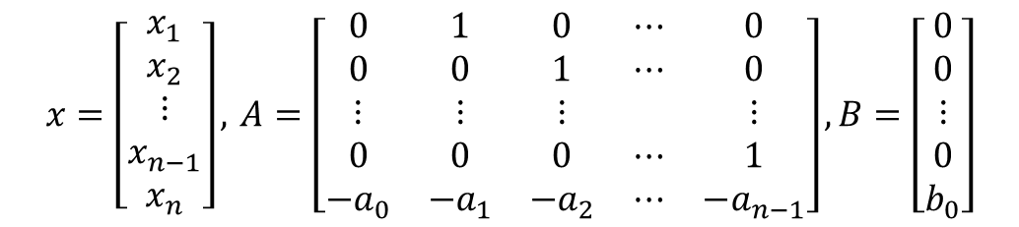

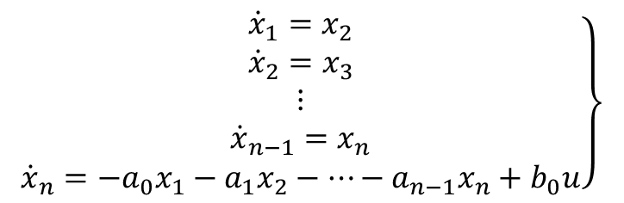
Selection of State Variables
1. Chose system output and its n-order derivatives
Case 1--- Differential equation without derivative of input variable
$$\left.\begin{matrix}{\dot{x}}_{1}=x_{2} \\ {\dot{x}}_{2}=x_{3} \\ ⋮ \\ {\dot{x}}_{n−1}=x_{n} \\ {\dot{x}}_{n}=−a_{0}x_{1}−a_{1}x_{2}−⋯−a_{n−1}x_{n}+b_{0}u\end{matrix}\right\}$$
$$y=x_{1}$$
$$x=\left[\begin{matrix}x_{1} \\ x_{2} \\ ⋮ \\ x_{n−1} \\ x_{n}\end{matrix}\right], A=\left[\begin{matrix}0 & 1 & 0 & ⋯ & 0 \\ 0 & 0 & 1 & ⋯ & 0 \\ ⋮ & ⋮ & ⋮ & & ⋮ \\ 0 & 0 & 0 & ⋯ & 1 \\ −a_{0} & −a_{1} & −a_{2} & ⋯ & −a_{n−1}\end{matrix}\right],B=\left[\begin{matrix}0 \\ 0 \\ ⋮ \\ 0 \\ b_{0}\end{matrix}\right]$$
$$c=\left[\begin{matrix}1 & 0 & ⋯ & 0\end{matrix}\right]$$

Slide 7
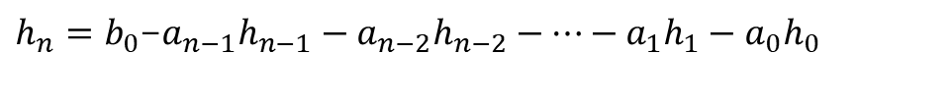
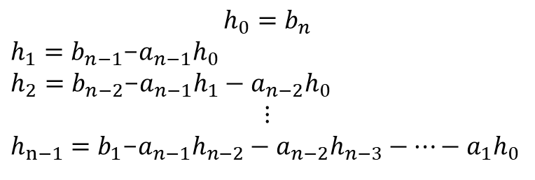


Selection of State Variables
Case 2--- Differential equation with derivative of input variable
Select state variable as
$$h_{0}=b_{n}$$
$h_{1}=b_{n−1}$-$a_{n−1}h_{0}$
$h_{2}=b_{n−2}$-$a_{n−1}h_{1}−a_{n−2}h_{0}$
$$⋮$$
$h_{n−1}=b_{1}$-$a_{n−1}h_{n−2}−a_{n−2}h_{n−3}−⋯−a_{1}h_{0}$
$h_{n}=b_{0}$-$a_{n−1}h_{n−1}−a_{n−2}h_{n−2}−⋯−a_{1}h_{1}−a_{0}h_{0}$
$$A=\left[\begin{matrix}0 & 1 & 0 & ⋯ & 0 \\ 0 & 0 & 1 & ⋯ & 0 \\ ⋮ & ⋮ & ⋮ & & ⋮ \\ 0 & 0 & 0 & ⋯ & 1 \\ −a_{0} & −a_{1} & −a_{2} & ⋯ & −a_{n−1}\end{matrix}\right],B=\left[\begin{matrix}h_{1} \\ h_{2} \\ ⋮ \\ h_{n−1} \\ h_{n}\end{matrix}\right]$$
$$c=\left[\begin{matrix}1 & 0 & ⋯ & 0\end{matrix}\right], D=h_{0}$$

Slide 8
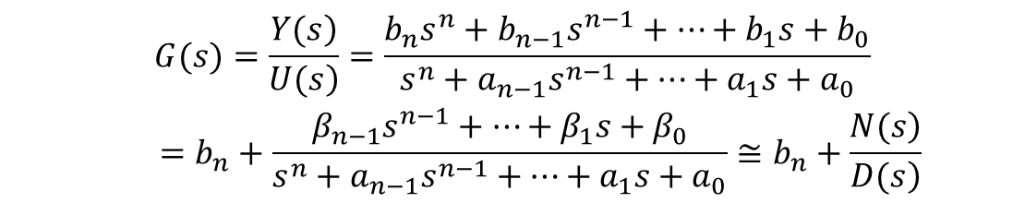

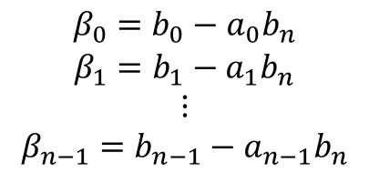
Selection of State Variables
2. State variables description from transfer function
$$\begin{matrix}G(s)=\frac{\left.Y(s\right)}{\left.U(s\right)}=\frac{b_{n}s^{n}+b_{n−1}s^{n−1}+⋯+b_{1}s+b_{0}}{s^{n}+a_{n−1}s^{n−1}+⋯+a_{1}s+a_{0}} \\ =b_{n}+\frac{β_{n−1}s^{n−1}+⋯+β_{1}s+β_{0}}{s^{n}+a_{n−1}s^{n−1}+⋯+a_{1}s+a_{0}}≅b_{n}+\frac{\left.N(s\right)}{\left.D(s\right)}\end{matrix}$$
where
$$\begin{matrix}β_{0}=b_{0}−a_{0}b_{n} \\ β_{1}=b_{1}−a_{1}b_{n} \\ ⋮ \\ β_{n−1}=b_{n−1}−a_{n−1}b_{n}\end{matrix}$$
Case 1 The series decomposition of
$$\frac{\left.N(s\right)}{\left.D(s\right)}$$
U(s)
Z(s)
Y(s)

Slide 9
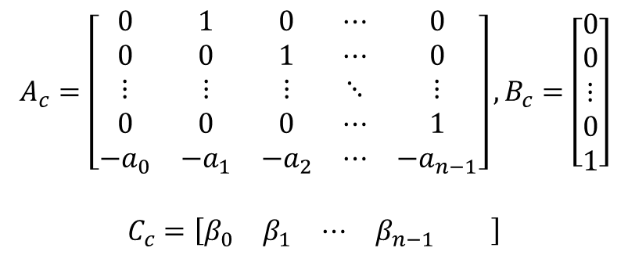
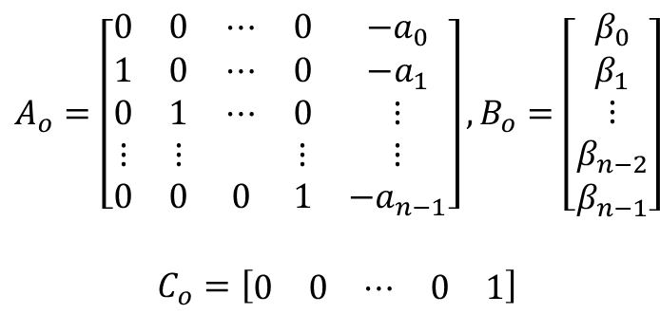
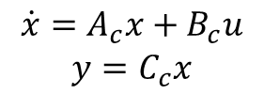
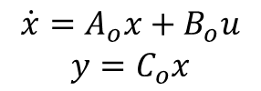
Selection of State Variables
2. State variables description from transfer function
Controllable Canonical Form
$$\begin{matrix}\dot{x}=A_{c}x+B_{c}u \\ y=C_{c}x\end{matrix}$$
$$\begin{matrix}A_{o}=\left[\begin{matrix}0 & 0 & ⋯ & 0 & −a_{0} \\ 1 & 0 & ⋯ & 0 & −a_{1} \\ 0 & 1 & ⋯ & 0 & ⋮ \\ ⋮ & ⋮ & & ⋮ & ⋮ \\ 0 & 0 & 0 & 1 & −a_{n−1}\end{matrix}\right],B_{o}=\left[\begin{matrix}β_{0} \\ β_{1} \\ ⋮ \\ β_{n−2} \\ β_{n−1}\end{matrix}\right] \\ \\ C_{o}=\left[\begin{matrix}0 & 0 & ⋯ & 0 & 1\end{matrix}\right]\end{matrix}$$
Observable Canonical Form
$$\begin{matrix}\dot{x}=A_{o}x+B_{o}u \\ y=C_{o}x\end{matrix}$$

Slide 10
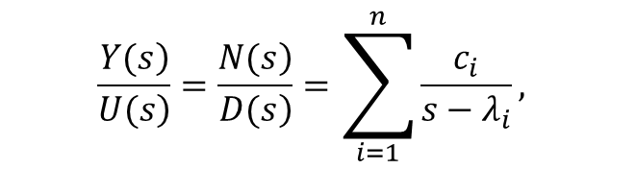
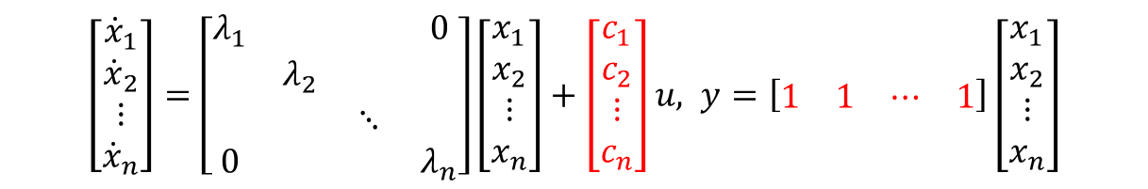


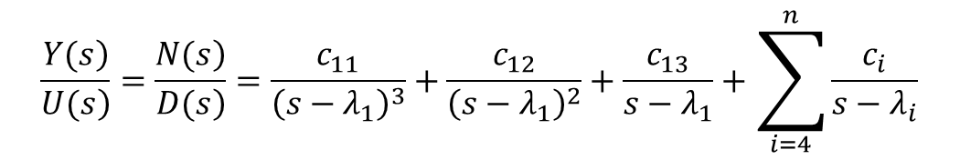
Selection of State Variables
Case 2 has distinct poles
$$\frac{\left.N(s\right)}{\left.D(s\right)}$$
$$\frac{\left.Y(s\right)}{\left.U(s\right)}=\frac{\left.N(s\right)}{\left.D(s\right)}=\sum_{i=1}^{n}{\frac{c_{i}}{s−λ_{i}}},$$
$$\left[\begin{matrix}{\dot{x}}_{1} \\ {\dot{x}}_{2} \\ ⋮ \\ {\dot{x}}_{n}\end{matrix}\right]=\left[\begin{matrix}λ_{1} & & & 0 \\ & λ_{2} & & \\ & & ⋱ & \\ 0 & & & λ_{n}\end{matrix}\right]\left[\begin{matrix}x_{1} \\ x_{2} \\ ⋮ \\ x_{n}\end{matrix}\right]+\left[\begin{matrix}c_{1} \\ c_{2} \\ ⋮ \\ c_{n}\end{matrix}\right]u, y=\left[\begin{matrix}1 & 1 & ⋯ & 1\end{matrix}\right]\left[\begin{matrix}x_{1} \\ x_{2} \\ ⋮ \\ x_{n}\end{matrix}\right]$$
$$\frac{\left.Y(s\right)}{\left.U(s\right)}=\frac{\left.N(s\right)}{\left.D(s\right)}=\frac{c_{11}}{{\left(s−λ_{1}\right)}^{3}}+\frac{c_{12}}{{\left(s−λ_{1}\right)}^{2}}+\frac{c_{13}}{s−λ_{1}}+\sum_{i=4}^{n}{\frac{c_{i}}{s−λ_{i}}}$$
$$\left\{\begin{matrix}\left[\begin{matrix}{\dot{x}}_{11} \\ \begin{matrix}{\dot{x}}_{12} \\ {\dot{x}}_{13} \\ {\dot{x}}_{4}\end{matrix} \\ ⋮ \\ {\dot{x}}_{n}\end{matrix}\right]=\left[\begin{matrix}\begin{matrix}λ_{1} & 1 & \\ & λ_{1} & 1 \\ & & λ_{1}\end{matrix} & & 0 & \\ & λ_{4} & & \\ 0 & & ⋱ & \\ & & & λ_{n}\end{matrix}\right]\left[\begin{matrix}x_{11} \\ \begin{matrix}x_{12} \\ x_{13} \\ x_{4}\end{matrix} \\ ⋮ \\ x_{n}\end{matrix}\right]+\left[\begin{matrix}0 \\ 0 \\ 1 \\ 1 \\ ⋮ \\ 1\end{matrix}\right]u \\ y=\left[\begin{matrix}c_{11} & c_{12} & c_{13} & c_{4} & ⋯ & c_{n}\end{matrix}\right]x\end{matrix}\right.$$

Slide 11
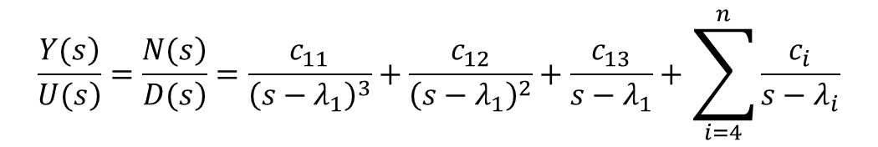


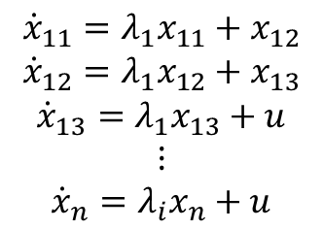
Selection of State Variables
Case 3 has repeat poles
$$\frac{\left.N(s\right)}{\left.D(s\right)}$$
$$\frac{\left.Y(s\right)}{\left.U(s\right)}=\frac{\left.N(s\right)}{\left.D(s\right)}=\frac{c_{11}}{{\left(s−λ_{1}\right)}^{3}}+\frac{c_{12}}{{\left(s−λ_{1}\right)}^{2}}+\frac{c_{13}}{s−λ_{1}}+\sum_{i=4}^{n}{\frac{c_{i}}{s−λ_{i}}}$$
State equation
$$\begin{matrix}{\dot{x}}_{11}=λ_{1}x_{11}+x_{12} \\ {\dot{x}}_{12}=λ_{1}x_{12}+x_{13} \\ {\dot{x}}_{13}=λ_{1}x_{13}+u \\ ⋮ \\ {\dot{x}}_{n}=λ_{i}x_{n}+u\end{matrix}$$
Jordan canonical form
$$\left\{\begin{matrix}\left[\begin{matrix}{\dot{x}}_{11} \\ \begin{matrix}{\dot{x}}_{12} \\ {\dot{x}}_{13} \\ {\dot{x}}_{4}\end{matrix} \\ ⋮ \\ {\dot{x}}_{n}\end{matrix}\right]=\left[\begin{matrix}\begin{matrix}λ_{1} & 1 & \\ & λ_{1} & 1 \\ & & λ_{1}\end{matrix} & & 0 & \\ & λ_{4} & & \\ 0 & & ⋱ & \\ & & & λ_{n}\end{matrix}\right]\left[\begin{matrix}x_{11} \\ \begin{matrix}x_{12} \\ x_{13} \\ x_{4}\end{matrix} \\ ⋮ \\ x_{n}\end{matrix}\right]+\left[\begin{matrix}0 \\ 0 \\ 1 \\ 1 \\ ⋮ \\ 1\end{matrix}\right]u \\ y=\left[\begin{matrix}c_{11} & c_{12} & c_{13} & c_{4} & ⋯ & c_{n}\end{matrix}\right]x\end{matrix}\right.$$

Slide 12
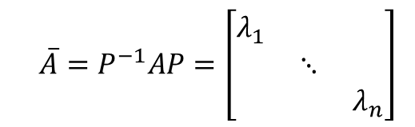



Linear transform of state-space model
Special case 1: Diagonal form of Matrix A
$$\begin{matrix}\dot{x}=Ax+Bu \\ \end{matrix}$$
$$λ_{1}，λ_{2}，⋯，λ_{n}$$
(1) If matrix A has distinct eigenvalues
$$Exist nonsingular matrix P$$
$${\overline{A}=P}^{−1}AP=\left[\begin{matrix}λ_{1} & & \\ & ⋱ & \\ & & λ_{n}\end{matrix}\right]$$
$$P=\left[\begin{matrix}p_{1} & p_{2} & ... & p_{n}\end{matrix}\right],p_{i} is eigenvectors ac{cording to λ}_{i}$$

Slide 13
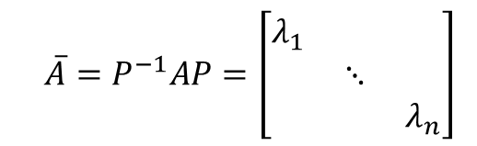
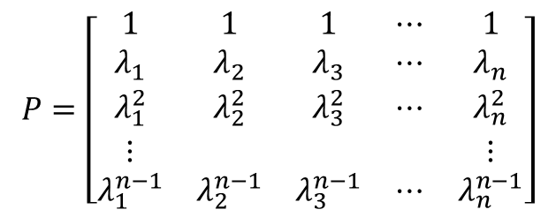
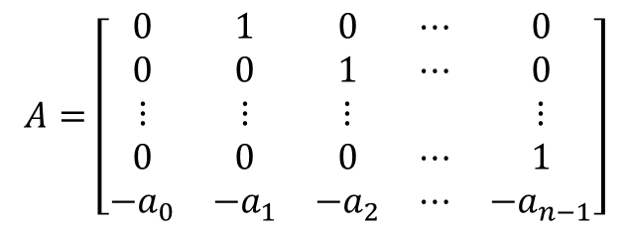

Linear transform of state-space model
Special case 1: Diagonal form of Matrix A
$$\begin{matrix}\dot{x}=Ax+Bu \\ \end{matrix}$$
If matrix A is companion matrix with distinct eigenvalues
$$λ_{1}，λ_{2}，⋯，λ_{n}$$
$$A=\left[\begin{matrix}0 & 1 & 0 & ⋯ & 0 \\ 0 & 0 & 1 & ⋯ & 0 \\ ⋮ & ⋮ & ⋮ & & ⋮ \\ 0 & 0 & 0 & ⋯ & 1 \\ −a_{0} & −a_{1} & −a_{2} & ⋯ & −a_{n−1}\end{matrix}\right]$$
$$P=\left[\begin{matrix}1 & 1 & 1 & ⋯ & 1 \\ λ_{1} & λ_{2} & λ_{3} & ⋯ & λ_{n} \\ λ_{1}^{2} & λ_{2}^{2} & λ_{3}^{2} & ⋯ & λ_{n}^{2} \\ ⋮ & & & & ⋮ \\ λ_{1}^{n−1} & λ_{2}^{n−1} & λ_{3}^{n−1} & ⋯ & λ_{n}^{n−1}\end{matrix}\right]$$
$${\overline{A}=P}^{−1}AP=\left[\begin{matrix}λ_{1} & & \\ & ⋱ & \\ & & λ_{n}\end{matrix}\right]$$
Which satisfies

Slide 14

Linear transform of state-space model
Special case 2: Jordan form of Matrix A
If matrix A is companion matrix with repeat eigenvalues
And (n-m) distinct eigenvalues
$$λ_{m+1}，λ_{m+2}，⋯，λ_{n}$$
m-order Jordan Block

Slide 15



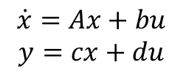





Transfer function matrix
SISO system-----Transfer Function (TF)
MIMO system----Transfer Function Matrix
Consider SISO LTI system
$$\begin{matrix}\dot{x}=Ax+bu \\ y=cx+du\end{matrix}$$
$$x\left(0\right)=0$$
Taking Laplace transform on both sides of the above equation
$$sx\left(s\right)=Ax\left(s\right)+bu\left(s\right)$$
$$y\left(s\right)=cx\left(s\right)+du\left(s\right)$$
Solving for $x\left(s\right)$, we obtain
$$\left(sI−A\right)x\left(s\right)=bu\left(s\right)$$
$$x\left(s\right)={\left(sI−A\right)}^{−1}bu\left(s\right)$$
$$y\left(s\right)=\left[c{\left(sI−A\right)}^{−1}b+d\right]u\left(s\right)$$
Transfer function is
g$\left(s\right)=c{\left(sI−A\right)}^{−1}b+d=\frac{cadj\left(sI−A\right)b+d|sI−A|}{|sI−A|}$
Remark: 1) Characteristic polynomial of A= Denominator polynomial of TF
2) Eig(A) =poles of TF

Slide 16









Transfer function matrix
Consider MIMO LTI system
$$\begin{matrix}\dot{x}=Ax+Bu \\ y=Cx+Du\end{matrix}$$
$$x\left(0\right)=0$$
Taking Laplace transform on both sides of the above equation
$$sx\left(s\right)=Ax\left(s\right)+Bu\left(s\right)$$
$$y\left(s\right)=Cx\left(s\right)+Du\left(s\right)$$
Solving for $x\left(s\right)$, we obtain
$$\left(sI−A\right)x\left(s\right)=Bu\left(s\right)$$
$$x\left(s\right)={\left(sI−A\right)}^{−1}Bu\left(s\right)$$
$$y\left(s\right)=\left[C{\left(sI−A\right)}^{−1}B+D\right]u\left(s\right)$$
Transfer function is
G$\left(s\right)=C{\left(sI−A\right)}^{−1}B+D$
Remark: Equivalence transformation does not change system transfer matrix
$$\overline{C}{\left(sI−\overline{A}\right)}^{−1}\overline{B}=CP^{−1}{\left(sI−PAP^{−1}\right)}^{−1}PB=C(sI−A)B$$

Slide 17





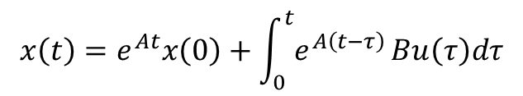
Solution to homogeneous state equation
Homogeneous state equation
$$\dot{x}=Ax$$
$$u=0$$
$$x\left(t\right)=L^{−1}\left[{\left(sI−A\right)}^{−1}\right]x\left(0\right)=e^{At}x\left(0\right)$$
Nonhomogeneous state equation
$$\dot{x}=Ax+Bu$$
$$x\left(t\right)=e^{At}x\left(0\right)+\int_{0}^{t}{e^{A\left(t−τ\right)}}Bu\left(τ\right)dτ$$
$$free motion caused by initial state$$
$$motion controled by input$$

Slide 18
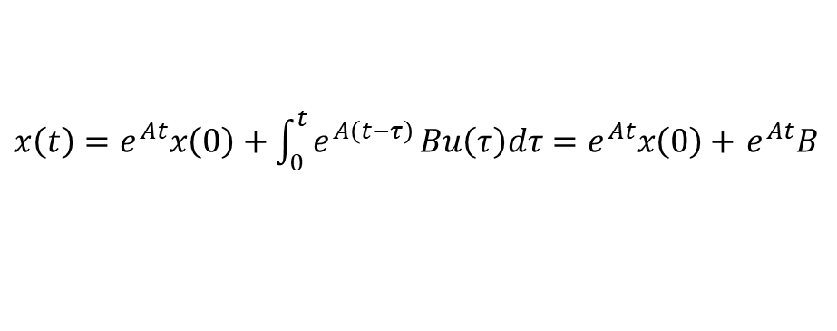

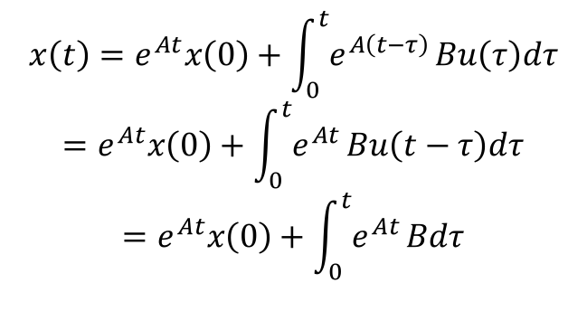


Solution to nonhomogeneous state equation
Nonhomogeneous state equation
$$\dot{x}=Ax+Bu$$
Case 1: when the input is impulse signal $δ(t)$
$x\left(t\right)=e^{At}x\left(0\right)+\int_{0}^{t}{e^{A\left(t−τ\right)}}Bu\left(τ\right)dτ=e^{At}x\left(0\right)+$ $e^{At}B$
Case 2: when the input is step signal u$(t)$
$$x\left(t\right)=e^{At}x\left(0\right)+\int_{0}^{t}{e^{A\left(t−τ\right)}}Bu\left(τ\right)dτ$$
$$=e^{At}x\left(0\right)+\int_{0}^{t}{e^{At}}Bu\left(t−τ\right)dτ$$
$$=e^{At}x\left(0\right)+\int_{0}^{t}{e^{At}}Bdτ$$
convolution theorem

Slide 19




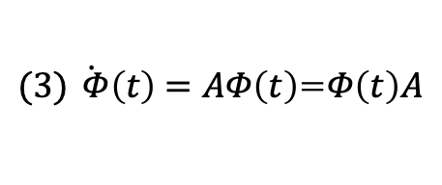

Solution to homogeneous state equation
Property of state transition matrix$Φ\left(t\right)$
$$\text{(1)} x\left(t\right)=Φ\left(t−t_{0}\right)x\left(t_{0}\right)$$
$$\text{(}\text{2}\text{)} Φ\left(0\right)=e^{A0}=I$$
$\text{(}\text{3}\text{)} \dot{ Φ}\left(t\right)=AΦ\left(t\right)$=$Φ\left(t\right)A$
$$\dot{Φ}\left(0\right)=A$$
$${\text{(}\text{4}\text{)} \left[Φ\left(t\right)\right]}^{k}=Φ\left(kt\right)$$
$\text{(}\text{5}\text{)} Φ\left(t_{2}−t_{1}\right)Φ\left(t_{1}−t_{0}\right)$=$Φ\left(t_{2}−t_{0}\right)$

Slide 20
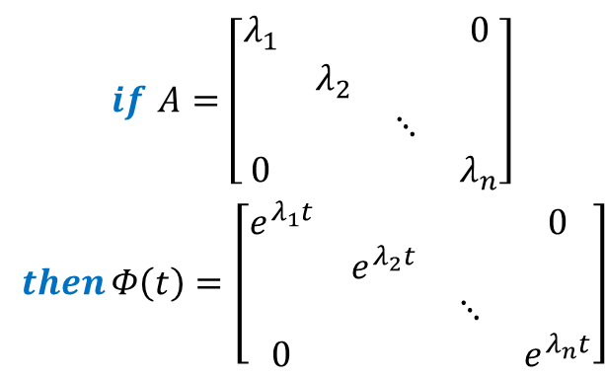
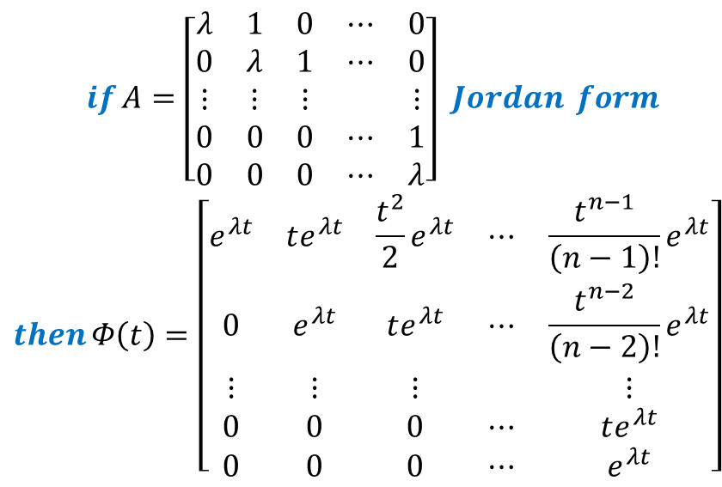
Solution to homogeneous state equation
$$\begin{matrix}if A=\left[\begin{matrix}λ_{1} & & & 0 \\ & λ_{2} & & \\ & & ⋱ & \\ 0 & & & λ_{n}\end{matrix}\right] \\ then Φ\left(t\right)=\left[\begin{matrix}e^{λ_{1}t} & & & 0 \\ & e^{λ_{2}t} & & \\ & & ⋱ & \\ 0 & & & e^{λ_{n}t}\end{matrix}\right] \end{matrix}$$
(6)
$$\begin{matrix}if A=\left[\begin{matrix}λ & 1 & 0 & ⋯ & 0 \\ 0 & λ & 1 & ⋯ & 0 \\ ⋮ & ⋮ & ⋮ & & ⋮ \\ 0 & 0 & 0 & ⋯ & 1 \\ 0 & 0 & 0 & ⋯ & λ\end{matrix}\right] Jordan form \\ then Φ\left(t\right)=\left[\begin{matrix}e^{λt} & te^{λt} & \frac{t^{2}}{2}e^{λt} & ⋯ & \frac{t^{n−1}}{\left(n−1\right)!}e^{λt} \\ 0 & e^{λt} & te^{λt} & ⋯ & \frac{t^{n−2}}{\left(n−2\right)!}e^{λt} \\ ⋮ & ⋮ & ⋮ & & ⋮ \\ 0 & 0 & 0 & ⋯ & te^{λt} \\ 0 & 0 & 0 & ⋯ & e^{λt}\end{matrix}\right] \end{matrix}$$

Slide 21
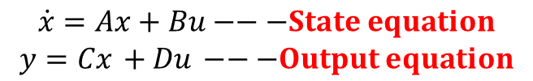
Controllability and observability
State Space Description:
$$\begin{matrix}\dot{x}=Ax+Bu−−−State equation \\ y=Cx +Du −−−Output equation\end{matrix}$$
Controllability ---- can the input control the state
Observability ---- can the output reflect the changes of state

Slide 22
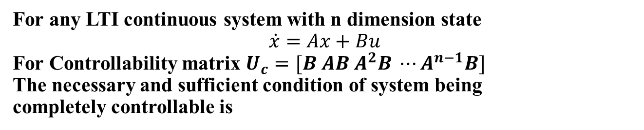

Controllability and observability
Output controllability
For any LTI continuous system with m dimension output
The necessary and sufficient condition of system output being
completely controllable is
1. Controllability criteria
For any LTI continuous system with n dimension state
$$\dot{x}=Ax+Bu$$
For Controllability matrix $U_{c}=[B AB A^{2}B ⋯A^{n−1}B]$
The necessary and sufficient condition of system being
completely controllable is
$${rank U}_{c}=n$$

Slide 23

Controllability and observability
2. Controllability criteria: PBH criteria
For any LTI continuous system
$$\dot{x}=Ax+Bu$$
The necessary and sufficient condition of system being
completely controllable is
or

Slide 24

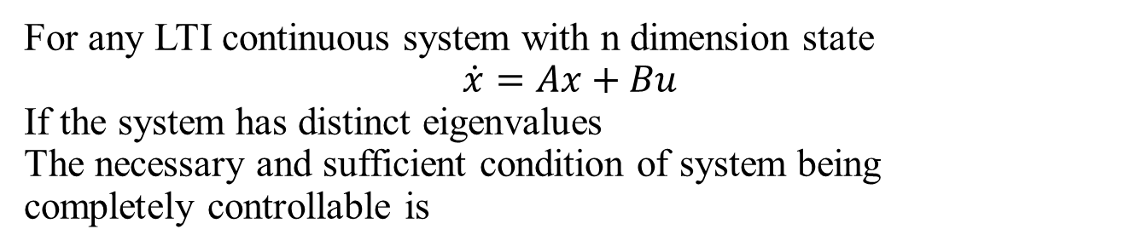
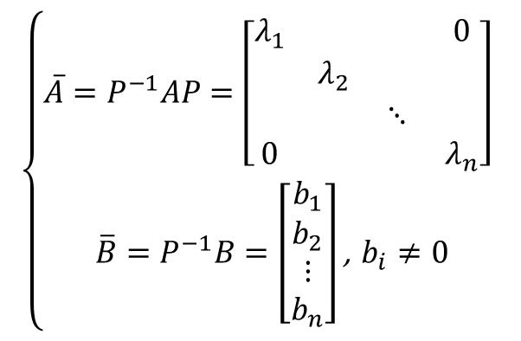

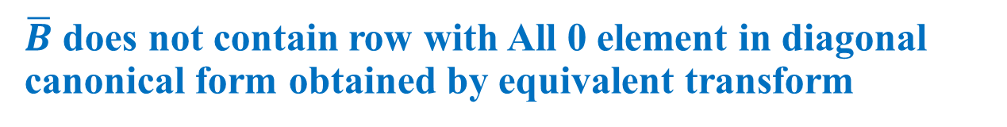
Controllability
3. Controllability criteria
For any LTI continuous system with n dimension state
$$\dot{x}=Ax+Bu$$
If the system has distinct eigenvalues
The necessary and sufficient condition of system being
completely controllable is
$$λ_{1}，λ_{2}，⋯，λ_{n}$$
$\overline{B}$ does not contain row with All 0 element in diagonal canonical form obtained by equivalent transform
$$\left\{\begin{matrix}\overline{A}=P^{−1}AP=\left[\begin{matrix}λ_{1} & & & 0 \\ & λ_{2} & & \\ & & ⋱ & \\ 0 & & & λ_{n}\end{matrix}\right] \\ \overline{B}=P^{−1}B=\left[\begin{aligned}b_{1} \\ b_{2} \\ ⋮ \\ b_{n}\end{aligned}\right]\text{,} b_{i}≠0\end{matrix}\right.$$
$$x=P\overline{x}⇒$$

Slide 25
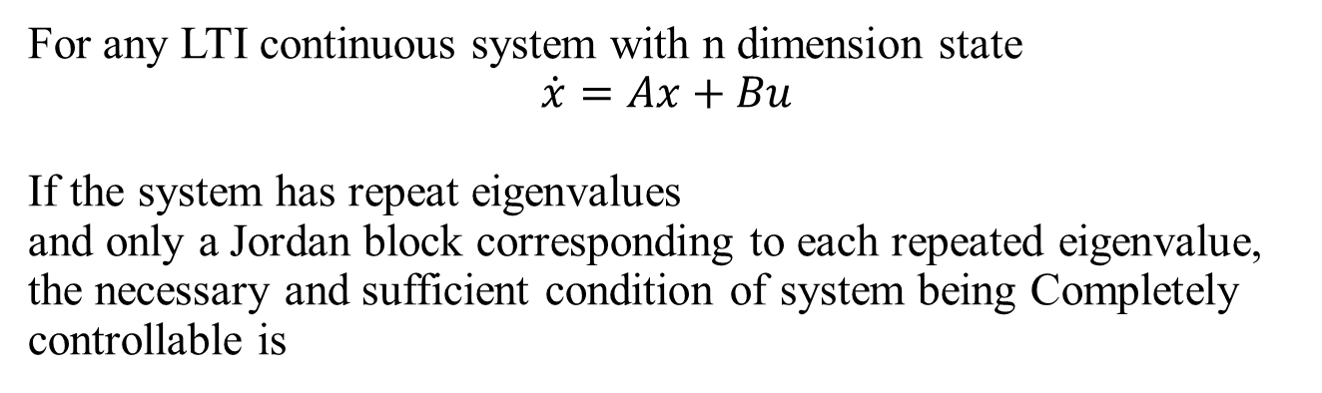
Controllability
4. Controllability criteria
For any LTI continuous system with n dimension state
$$\dot{x}=Ax+Bu$$
If the system has repeat eigenvalues
and only a Jordan block corresponding to each repeated eigenvalue, the necessary and sufficient condition of system being Completely controllable is
The elements of all these rows in matrix B which are corresponding of last row of every Jordan block J are not all 0.

Slide 26
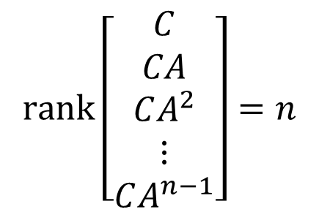

Observability
1. Observability criteria
For linear system $\dot{x}=Ax+Bu$, $y=Cx+Du$
the necessary and sufficient condition of system being completely observable is
$$rank\left[\begin{matrix}C \\ CA \\ CA^{2} \\ ⋮ \\ CA^{n−1}\end{matrix}\right]=n$$

Slide 27
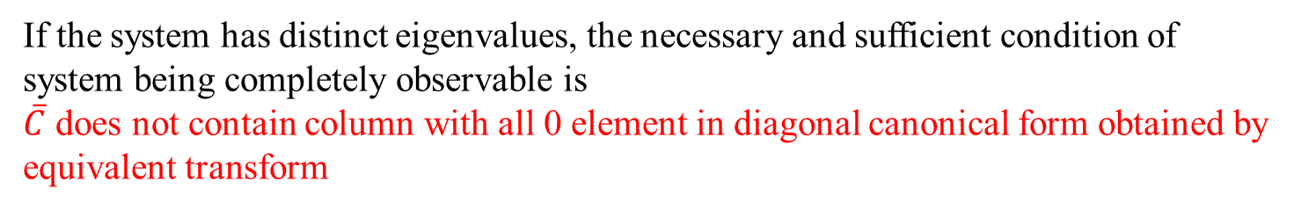
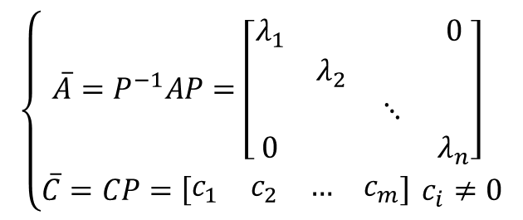

Observability
2. Observability criteria
For linear system $\dot{x}=Ax+Bu$, $y=Cx+Du$
If the system has distinct eigenvalues, the necessary and sufficient condition of system being completely observable is
$\overline{C}$ does not contain column with all 0 element in diagonal canonical form obtained by equivalent transform
$$\left\{\begin{matrix}\overline{A}=P^{−1}AP=\left[\begin{matrix}λ_{1} & & & 0 \\ & λ_{2} & & \\ & & ⋱ & \\ 0 & & & λ_{n}\end{matrix}\right] \\ \overline{C}=CP=\left[\begin{matrix}c_{1} & c_{2} & … & c_{m}\end{matrix}\right] c_{i}≠0\end{matrix}\right.$$
$$x=P\overline{x}⇒$$

Slide 28
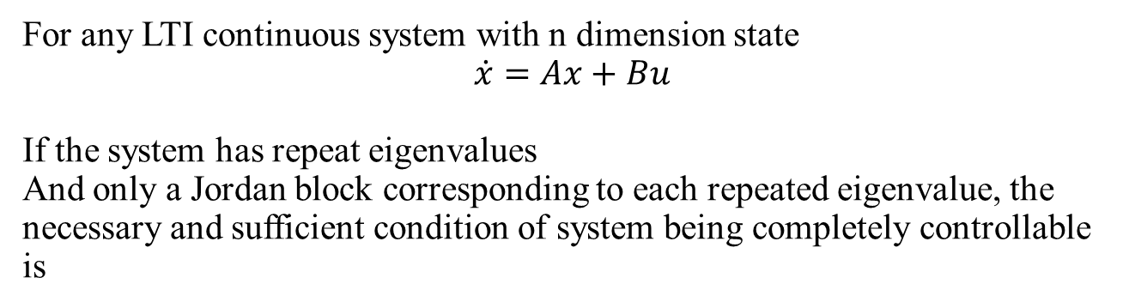
Observability
3. Observability criteria
For any LTI continuous system with n dimension state
$$\dot{x}=Ax+Bu$$
If the system has repeat eigenvalues
And only a Jordan block corresponding to each repeated eigenvalue, the necessary and sufficient condition of system being completely controllable is
The elements of all these rows in matrix B which are corresponding of last row of every Jordan block J are not all 0.

Slide 29


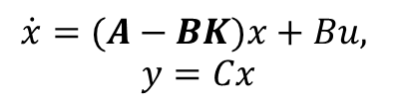

State feedback and output feedback
(1) State feedback
Consider a system
$$\dot{x}=Ax+Bu,$$
$$y=Cx$$
Introducing the state variable to the input terminal gives the state feedback control law
$$u=v−Kx$$
The closed-loop system is
$$\dot{x}=(A−BK)x+Bu,$$
$$y=Cx$$
The transfer function matrix
$$G=C{(sI−A+BK)}^{−1}B$$

Slide 30

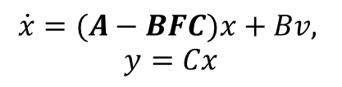
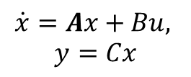

State feedback and output feedback
(2) Output feedback
Consider system
$$\dot{x}=Ax+Bu,$$
$$y=Cx$$
Introducing the output to the input terminal gives the output feedback control law
$$u=v−Fy$$
The closed-loop system is
$$\dot{x}=(A−BFC)x+Bv,$$
$$y=Cx$$
The transfer function matrix
$$G=C{(sI−A+BFC)}^{−1}B$$

Slide 31
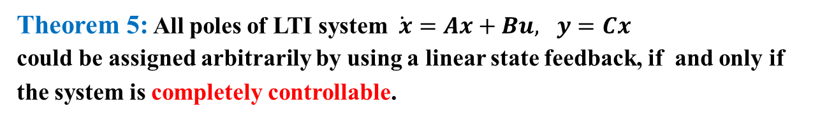
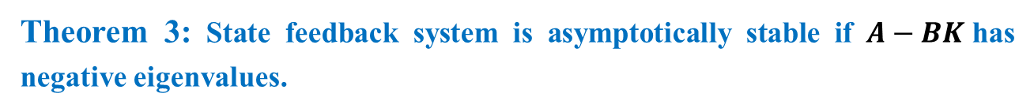
State feedback and output feedback
State feedback could improve system performance
State variables contain abundant system internal information
System stabilization
System pole placement
System stabilization
Theorem 3: State feedback system is asymptotically stable if $A−BK$has negative eigenvalues.
Theorem 4: If and only if the uncontrollable part is asymptotically stable, that the system can be stabilized by state feedback.
Pole placement by state feedback:
Theorem 5: All poles of LTI system $\dot{ x}=Ax+Bu, y=Cx$
could be assigned arbitrarily by using a linear state feedback, if and only if the system is completely controllable.

Slide 32

State Observer
(1) Full dimensional observer
$dim\left(\hat{x}\right)=dim(x)$=n
where is
observer system matrix
Theorem: If LTI system (A,B,C) is observable, then the state of observer could be estimated by and H can be
determined by arbitrarily assigned poles.

Slide 33



Pole placement for LTI system
How to determine the feedback gain matrix $K$
Determine if the system is controllable
Derive the closed-loop system characteristic polynomial
Derive the system characteristic polynomial with expected poles
The two polynomial should be the same, so the corresponding coefficients should be the same. Solving linear equation set to get the matrix.
$$|sI−A+BK|$$
$$\prod_{i=1}^{n}{\left(s−s_{i}\right)}$$

Slide 34


State observer for LTI system
How to determine the observer matrix $H$
Determine if the system is observable
Derive the closed-loop system characteristic polynomial
Derive the expected observer poles
The two polynomial should be the same, so the corresponding coefficients should be the same. Solving linear equation set to get the matrix.
$$|sI−A+HC|$$
$$\prod_{i=1}^{n}{\left(s−s_{i}\right)}$$

Slide 35
MATLAB code
Common commands:
G=ss(A, B, C, D)： (A, B, C, D) is coefficient matrix.
Gtf=tf(num,den),G=ss(Gtf): Transfer function.
Gz= ss(A, B, C, D,Ts): Discrete State Model Gz。(A, B, C,
D) is coefficient matrix of continuous system，Ts为Sampling Time.
[a,b,c,d]=ssdata(G): Extraction of coefficient matrix in model G, (a,b,c,d).
G.A: Extraction of coefficient matrix A in model G.

Slide 36

Matlab related functions
Transfer function G(s)
G=tf(num,den)
State space model (A,B,C,D)
$$\dot{x}=Ax+Bu,$$
$y=Cx$+$Du$
G=ss(A, B, C, D)
Zero-pole model G(s)
G=zpk(Z,P,K)

Slide 37
Matlab related functions
P438, Example 9-6
Transfer function G(s)
tf2ss,ss2tf
State space model (A,B,C,D)
tf2zp,zp2tf
ss2zp,zp2ss
Zero-pole model G(s)

Slide 38
Matlab related functions
Solutions of state space model
(1) Response of system with step signal as input：
G=ss(A,B,C,D);
[y,t,x]=step(G);
plot(t,x).
(2) u=0, homogenous state equation
[y,t,x]=initial(G,x0)
P435 Example 9-4

Slide 39
Matlab related functions
Controllability and observability of state space model
co=ctrb(A，B)
rank(co)
P458 Example 9-15,16
ob=obsv(A，C)
rank(ob)

Slide 40
Matlab related functions
Linear transform
[At，Bt，Ct，Dt]=ss2ss(A，B，C，D，T)

Slide 41
Matlab related functions
Diagonal form:
[At，Bt，Ct，Dt，T]=canon(A，B，C，D，'modal')
Observable canonical form:
[At，Bt，Ct，Dt，T]=canon(A，B，C，D，'companion')
Controllable canonical form:
[At，Bt，Ct，Dt，T]=canon(A，B，C，D，'companion')
[At'，Ct'，Bt'，Dt']
P512 exercise 9-6

Slide 42
Matlab related functions
Pole placement
K=place(A,B,P)
K=acker(A, b, p)
State observer
h=(acker(A',c',P_o))'
H=(place(A',c',P_o))'

Slide 43
Matlab related functions
Transfer function G(s)
G=tf(num,den)
State space model (A,B,C,D)
$$\dot{x}=Ax+Bu,$$
$y=Cx$+$Du$
G=ss(A, B, C, D)
Zero-pole model G(s)
G=zpk(Z,P,K)

Slide 44
Matlab related functions
P438, Example 9-6
Transfer function G(s)
tf2ss,ss2tf
State space model (A,B,C,D)
tf2zp,zp2tf
ss2zp,zp2ss
Zero-pole model G(s)

Slide 45
Matlab related functions
Solutions of state space model
(1) Response of system with step signal as input：
G=ss(A,B,C,D);
[y,t,x]=step(G);
plot(t,x).
(2) u=0, homogenous state equation
[y,t,x]=initial(G,x0)
P435 Example 9-4

Slide 46
Matlab related functions
Controllability and observability of state space model
co=ctrb(A，B)
rank(co)
P458 Example 9-15,16
ob=obsv(A，C)
rank(ob)

Slide 47
Matlab related functions
Linear transform
[At，Bt，Ct，Dt]=ss2ss(A，B，C，D，T)

Slide 48
Matlab related functions
Diagonal form:
[At，Bt，Ct，Dt，T]=canon(A，B，C，D，'modal')
Observable canonical form:
[At，Bt，Ct，Dt，T]=canon(A，B，C，D，'companion')
Controllable canonical form:
[At，Bt，Ct，Dt，T]=canon(A，B，C，D，'companion')
[At'，Ct'，Bt'，Dt']
P512 exercise 9-6

Slide 49
Matlab related functions
Pole placement
K=place(A,B,P)
K=acker(A, b, p)
State observer
h=(acker(A',c',P_o))'
H=(place(A',c',P_o))'

Slide 50
描述系统的状态方程不是唯一的。 ( )
线性定常系统经过非奇异线性变换后，系统的可控性不变。 ( )
用状态反馈进行系统极点配置可能会改变系统的可观测性。 ( )
由一个状态空间模型可以确定惟一一个传递函数。 ( )
稳定性问题是相对于某个平衡状态而言的。 ( )
若一个线性连续定常系统完全能控，则该系统一定可能通过状态反馈镇定。
任何一个方阵均可化为对角化的约当型。 ( )
对于线性连续定常系统的输出最优调节器问题的，采用的是输出反馈方式构造
控制器 ( )
李雅普诺夫第二法只给出了判定稳定性的充分条件。 ( )

Slide 51


Slide 52
Some questions
Linear transformation will change the system’s controllability. ( )
Transfer function of a system is unique. ( )
Stability under Lyapunov discusses the stability of balanced states ( )
Lyapunov function can be chosen as different positive definite functions ( )
Linear time invariant system has two balanced states. ( )
1. 系统的传递函数是唯一的，但描述系统的状态空间方程不唯一。
2. 李雅普诺夫函数可以选择不同的正定函数。
3.线性变换会改变系统的状态空间方程，同时改变了系统的特征值

